Slide 1

UM-SJTU JOINT INSTITUTE
Make Up Materials for RC 4 Integral (Part1)
VV156 TA GROUP

Slide 2
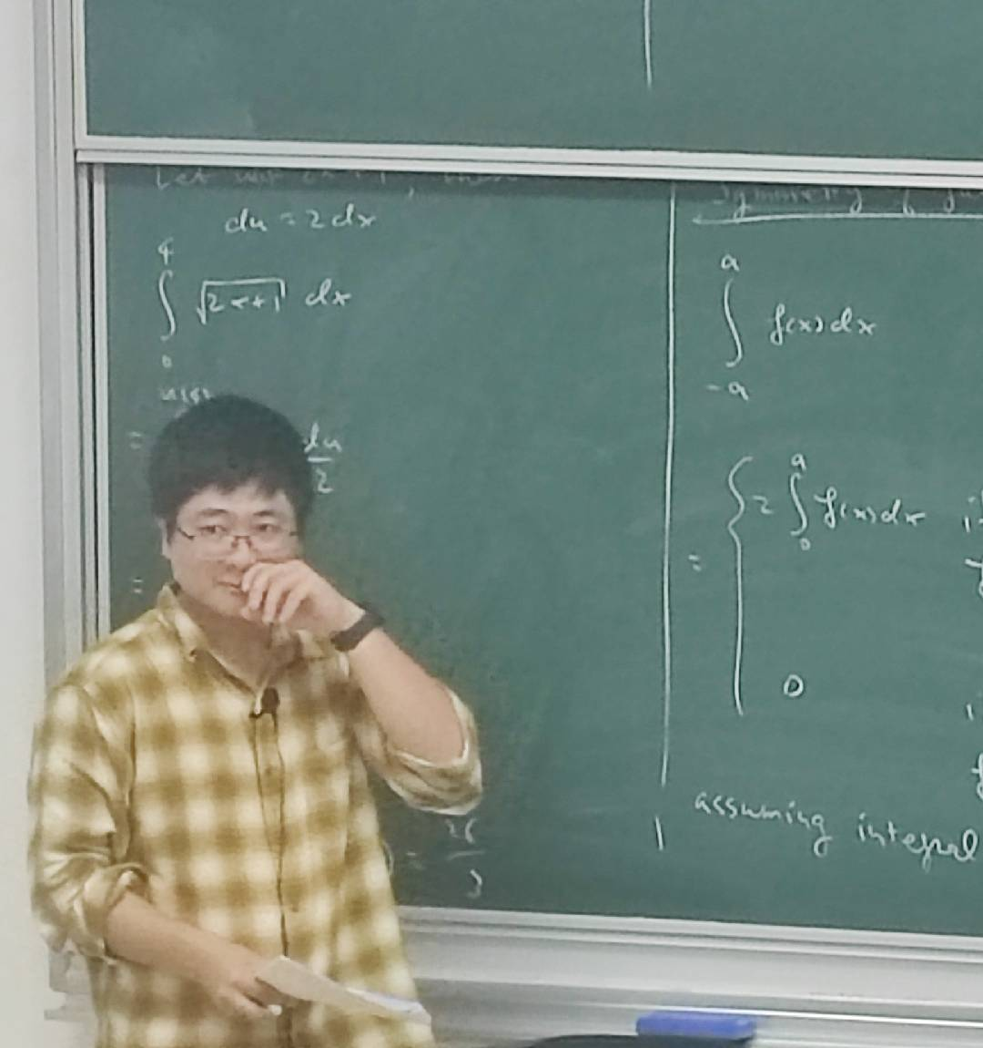
Contents
Partial Fraction (Very Important !!!)
CRZ’s Cover Method

Slide 3
Overall
1
What’s CRZ Cover Method?
2
How to use CRZ Cover Method?

Slide 4
Partial Fraction
If you have taken my course, such methods will be used three times, one is in VV156, one is in VV256, the other one is in VE203
--Runze Cai

Slide 5
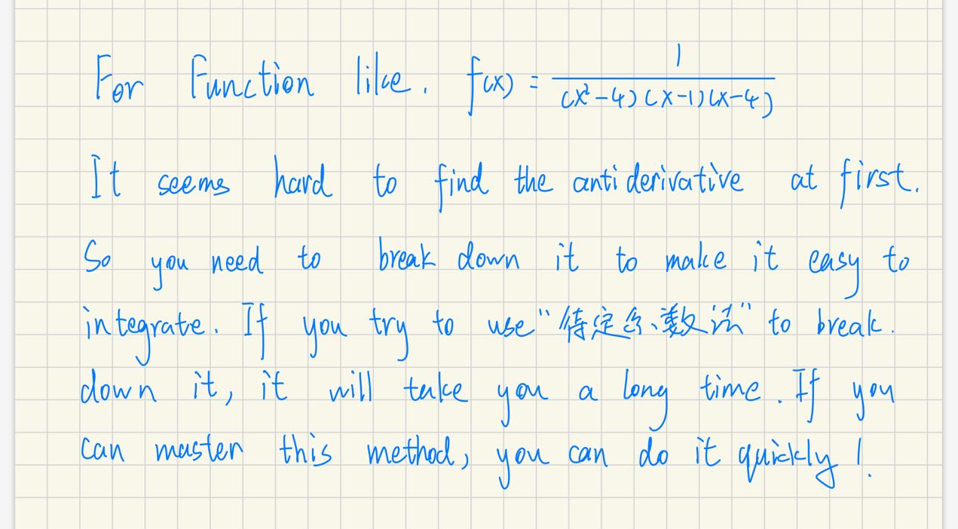
What’s Partial Fraction?

Slide 6
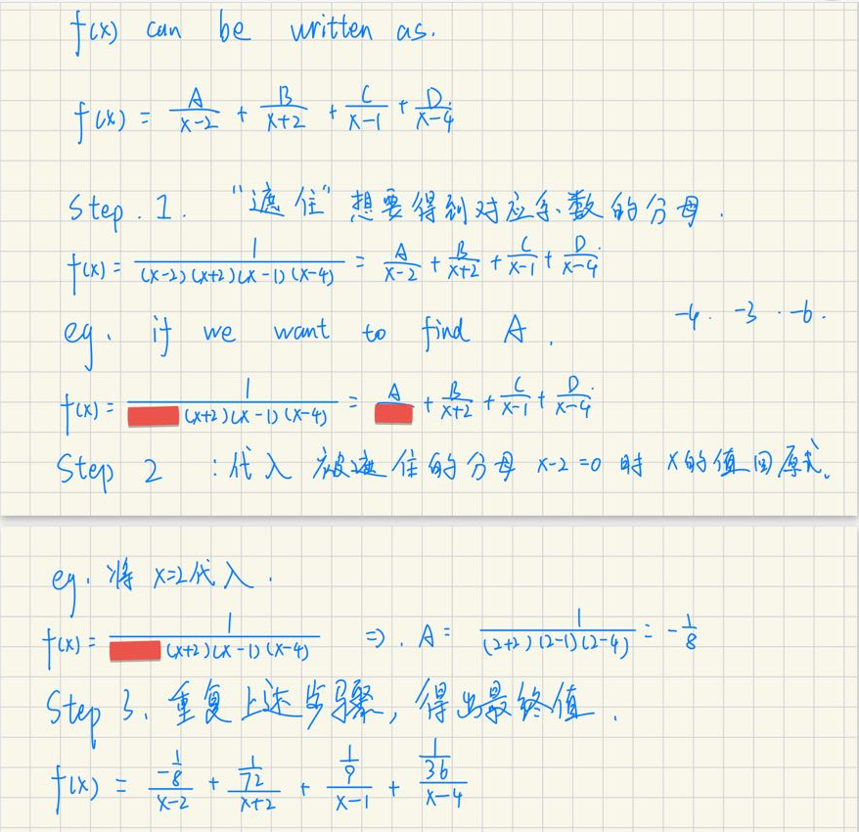
How to use Partial Fraction

Slide 7
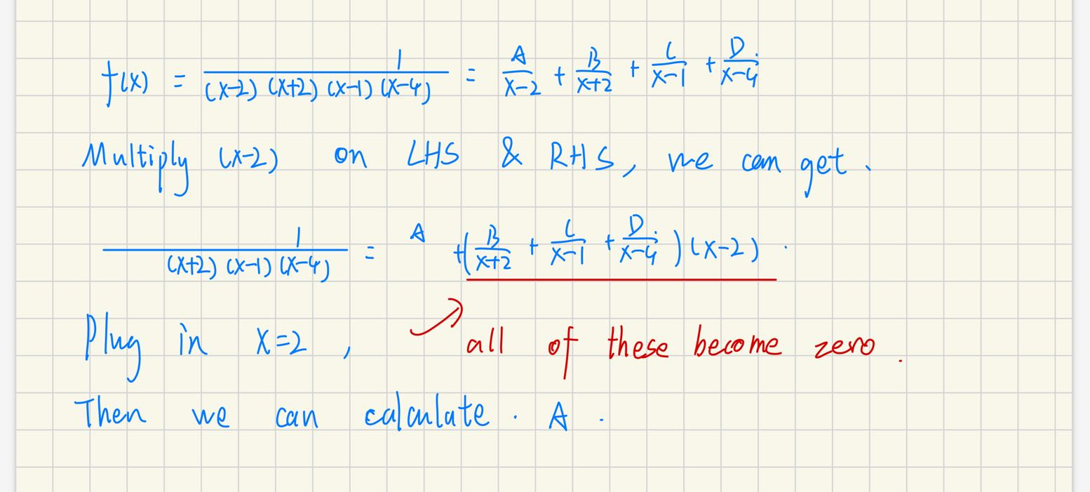
Why it is applicable?

Slide 8
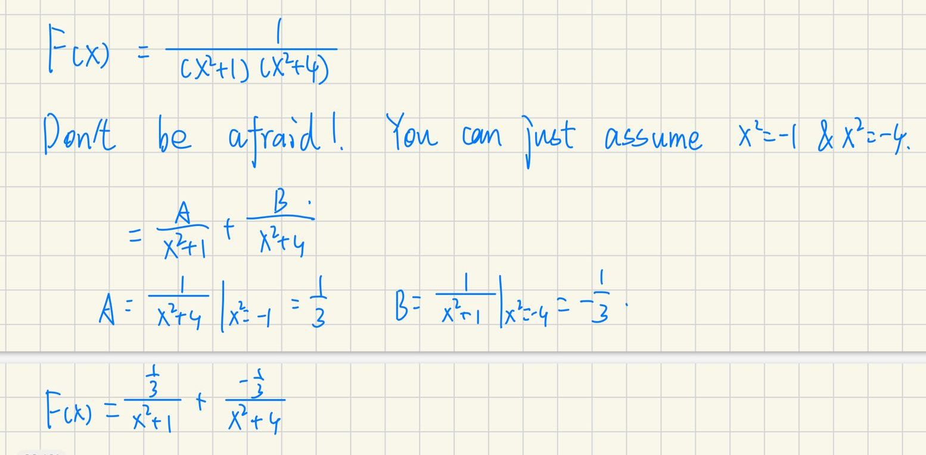
Some more abstract examples

Slide 9
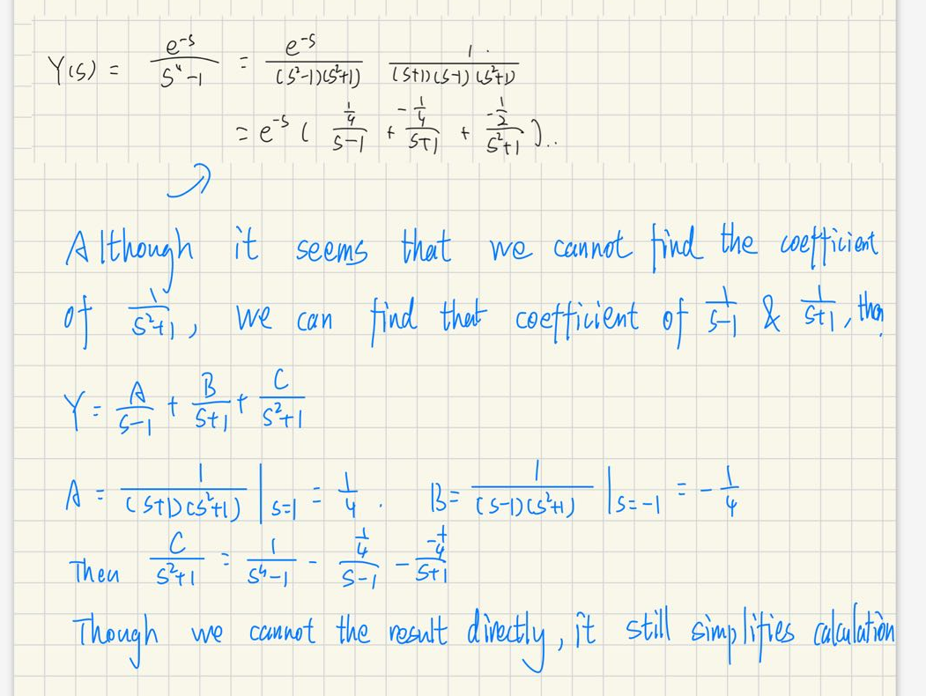
Some more abstract examples

Slide 10
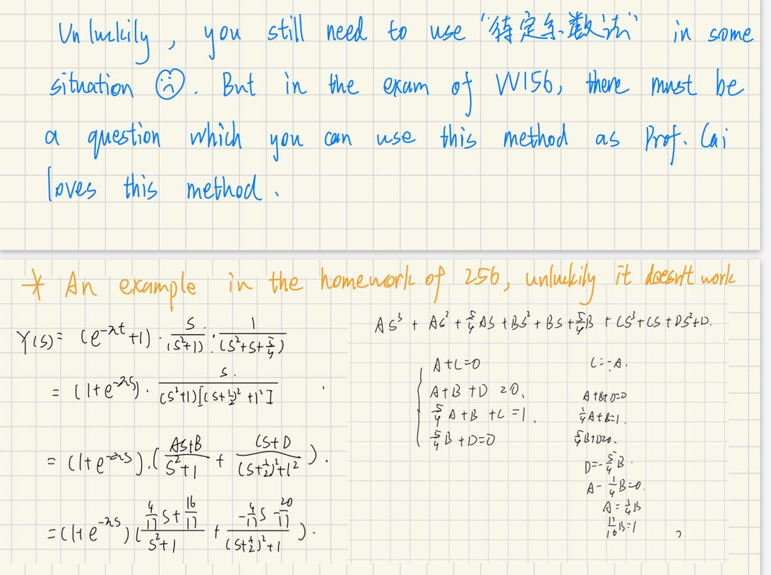
Some more abstract examples

Slide 11
THANK YOU！
ji.sjtu.edu.cn

